Slide 1



Reducing Photometric Redshift Uncertainties Through Galaxy Clustering
Pier fiedorowicz

Slide 2
Measuring Distances in Cosmology
Expansion of the Universe
Observable redshifts in light sources.
Spectroscopic Redshifts
Slow
Accurate
Photometric Redshifts
Fast
Large Errors

Slide 3
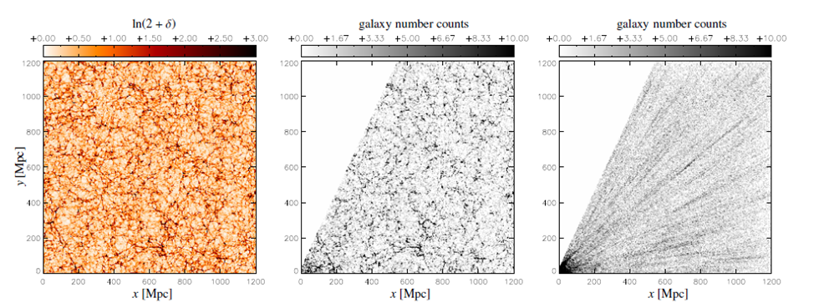
Radial Anisotropy – Simulation Data
Source: Jens Jasche http://arxiv.org/abs/1106.2757

Slide 4
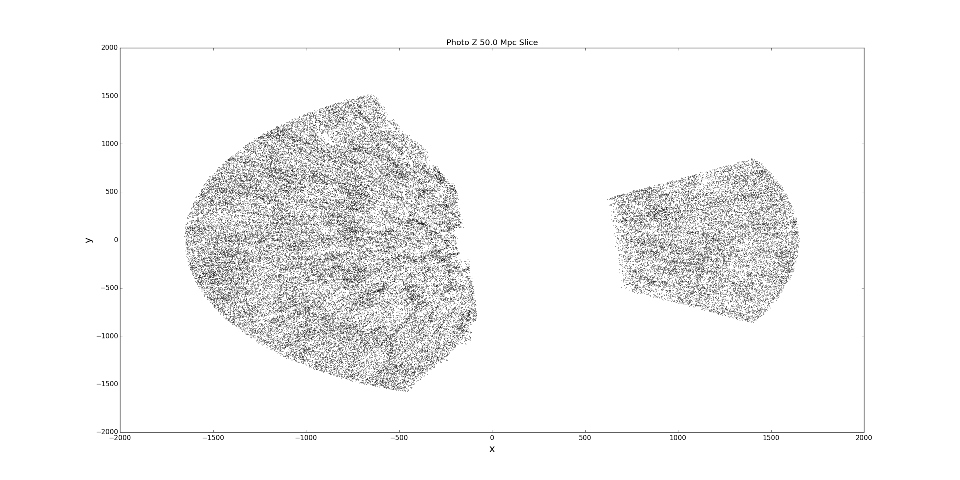
Radial Anisotropy – Real Data

Slide 5
Task
Develop a robust system capable of working with real survey data.
SDSS DR8 redMaGiC Catalog
Recover the true probability distribution functions for the redshifts of each galaxy.
Demand photometric redshifts be consistent with expected isotropic matter distribution of the Universe.

Slide 6
Bayesian Inference and MCMC
Matter distribution modeled as a homogenous and isotropic log-normal random field.
Simultaneously solve for mass distribution in the Universe, and galaxy redshifts that are consistent with photometric data, and the estimated mass density.
Use Monte Carlo Markov Chain to explore parameter space.
Use the MCMC results to fit/optimize model parameters using our data.
Returns probability distributions of fit parameters.

Slide 7

Model Parameters
Input
Observed Redshifts
Position in the Sky
Model Parameters
Density Field
True Redshift
High Dimensional Problem
Each pixel and each galaxy’s redshift is a parameter to be fit.
On the order of ${10}^{6}$ parameters to be fit.

Slide 8
Two Step Process
Density Map Sampling
Metropolis–Hastings
Random Walk
Hamiltonian Monte Carlo
Use Hamiltonian Mechanics
More Efficient
Redshift Sampling
Each galaxy can be sampled independently.
Exploit parallel computing.

Slide 9
Hamiltonian Method
Hamiltonian Mechanics - Energy
Positions
Momenta
Process:
Begin with an N-dimensional parameter space.
Add an additional N parameters to represent momenta.
Propagate system forward in time.
Samples regions where the total “energy” is conserved.
Acceptance rate is unity.

Slide 10
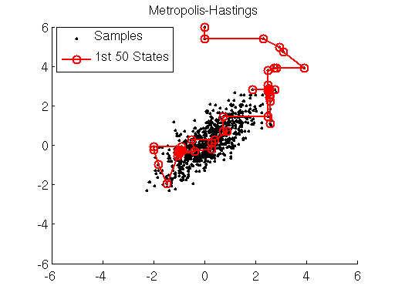
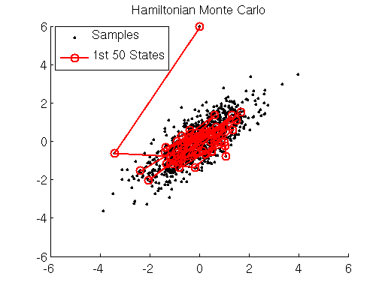
Hamiltonian Sampling
Source: http://theclevermachine.wordpress.com/

Slide 11
Progress
Still under development.
Completed
Hamiltonian Propagation
Density Map Likelihood and Sampling
In-Progress
Redshift Likelihood and Sampling
Remaining
MCMC Sampler
Results and Testing

Slide 12
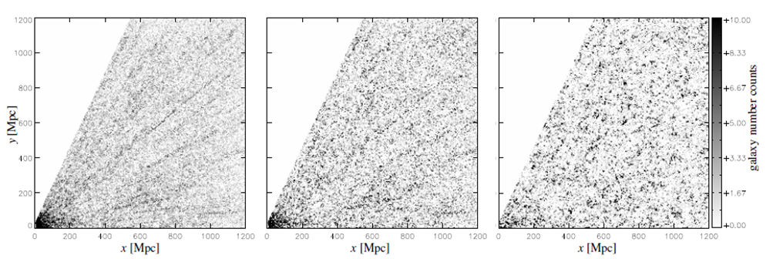
Continuing Work
On-Going Project
Senior Honors Thesis
Source: Jens Jasche http://arxiv.org/abs/1106.2757

Slide 13
Special Thanks
Professor Eduardo Rozo
Tom McClintock
Arizona Space Grant Consortium
University of Arizona Physics Department
Original Paper
Jens Jasche

Slide 14
Thank You

